Slide 1
Subject/ Verb Agreement
An important grammar skill
To make your sentences COHERENT, you must make your subjects and verbs agree with each other in number.

Slide 2
Two numbers in English:
Singular
Example: The boy loves his kite.
                (singular)
Plural
  Example: The boys love their kite. (plural)

Slide 3
Problems occur in the following cases
Words come between the subject and verb
The verb comes before the subject
The subject has two or more parts
The sentence contains an indefinite pronoun

Slide 4
1. Words coming between the subject and the verb
The girl with the beautiful dresses (is/are) here.
Find subject and verb
Find preposition phrase
Answer: girl is

Slide 5
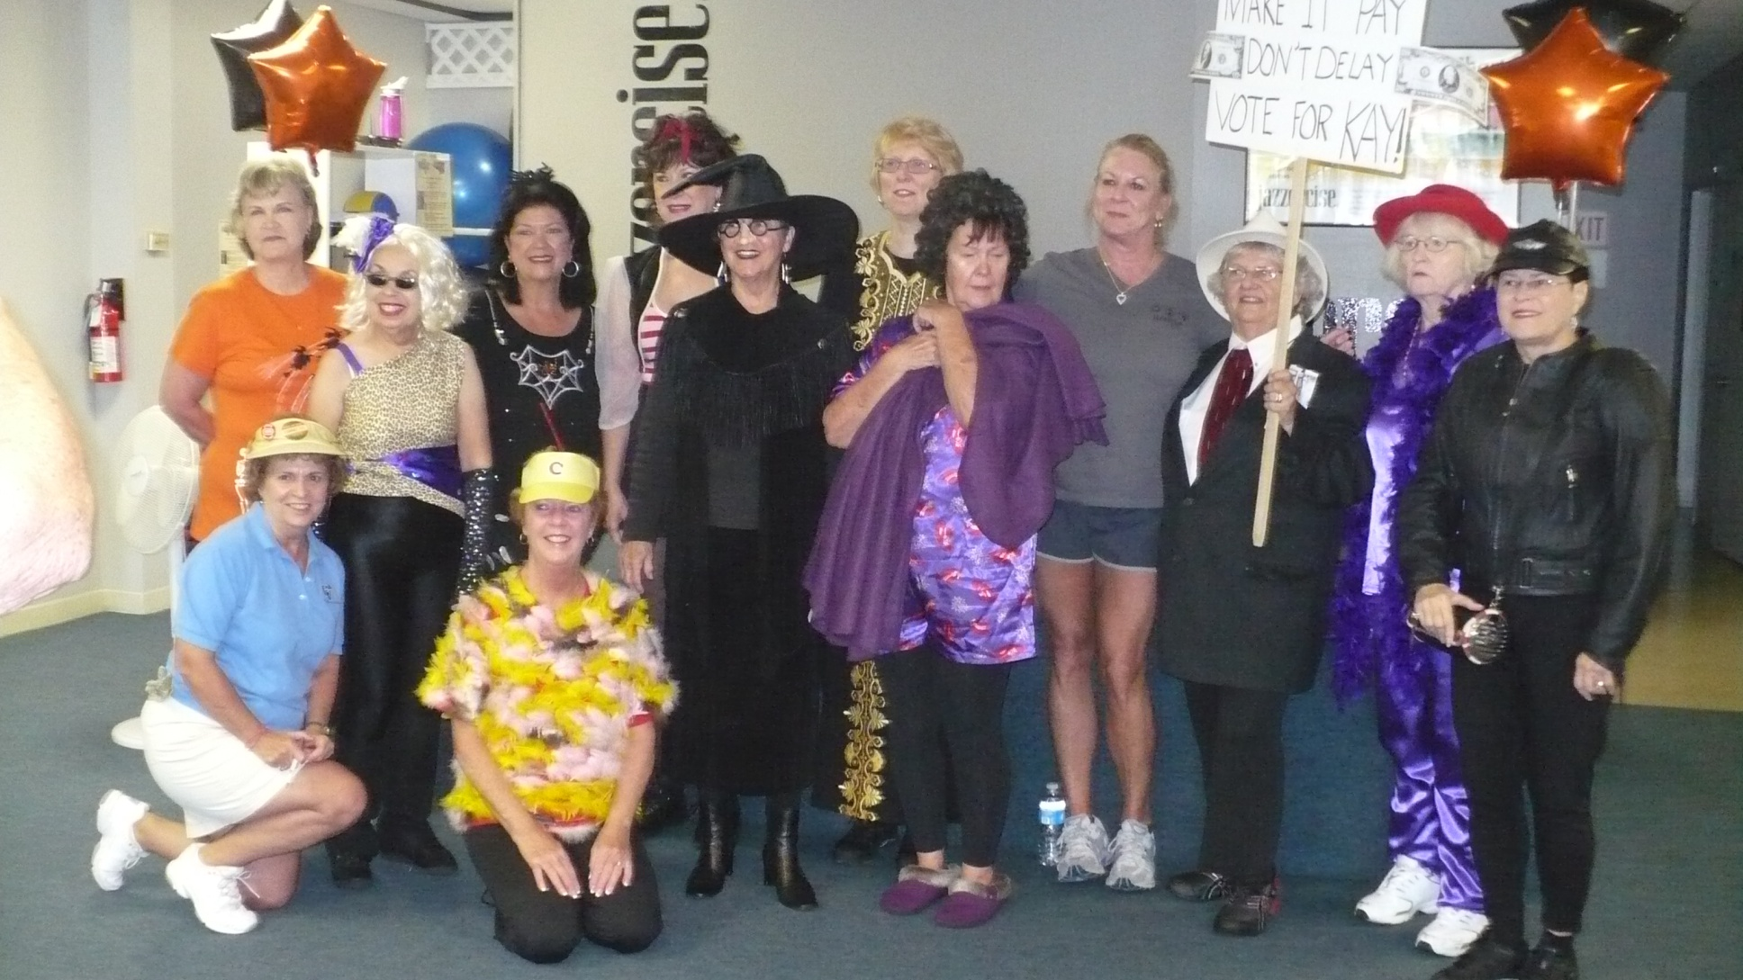
Find the Prof!

Slide 6
2. The verb comes before the subject.
In the book is/are many short stories.
Find the subjects and verbs
The singular subject short stories comes after the verb.
Answer: In the book are many short stories.

Slide 7
3. Agreement when the subject has two or more parts
Bach, Beethoven, and Brahms all come from Germany.
Find subjects and verbs
Bach, Beethoven, and Brahms –compound Answer: subject is “come”

Slide 8
Agreement when the subject is an indefinite pronoun

Slide 9
Indefinite Pronouns
Memorize These
Singular forms
Word that end with one, thing, or body
Any one
No thing
Some body
Every

Slide 10
Examples:
No one, including the students, (admit, admits) taking the CD.
Everyone of the girls (blame, blames) John.

Slide 11
Plural Indefinite Pronouns
Both
Few
Many
several

Slide 12
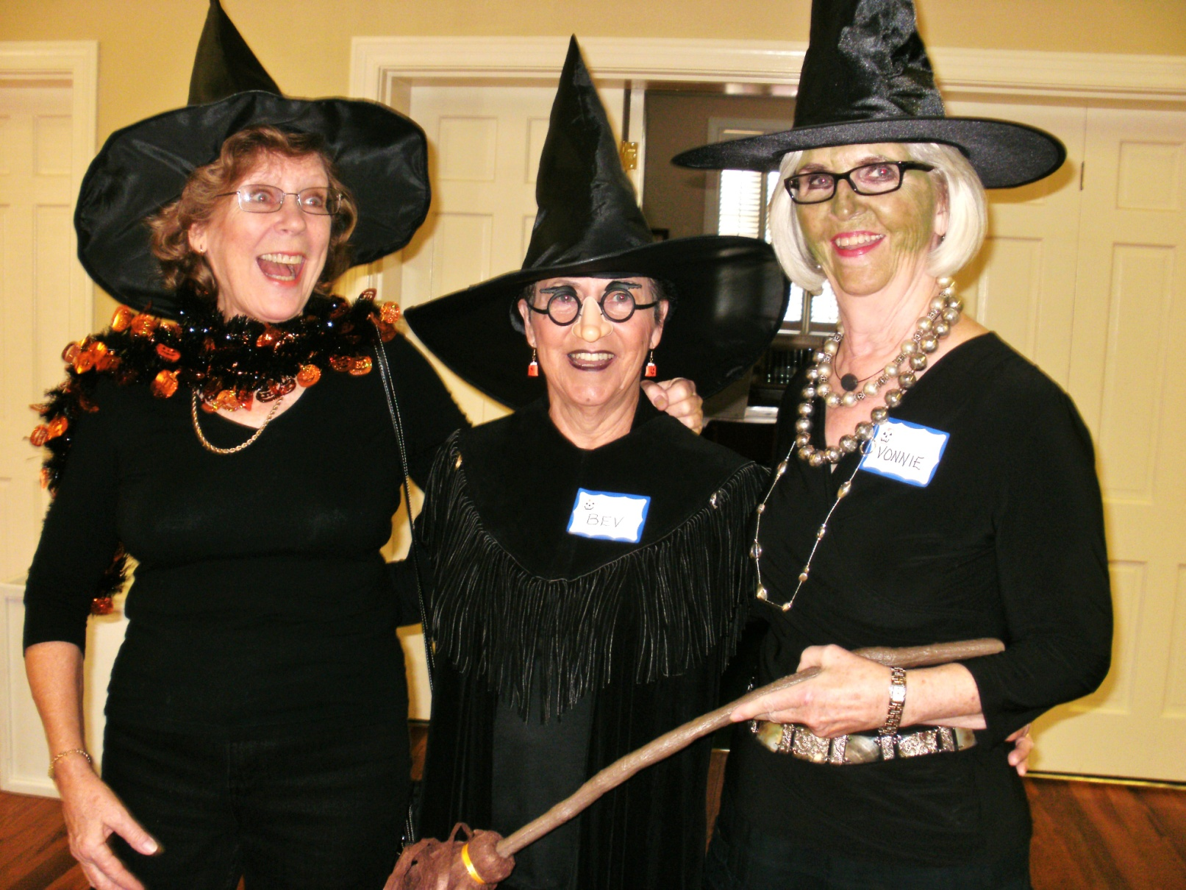
The Witches Three

